Slide 1
10.5 Nonlinear Multi-Class Classification

Slide 2
Modeling principles

Slide 3
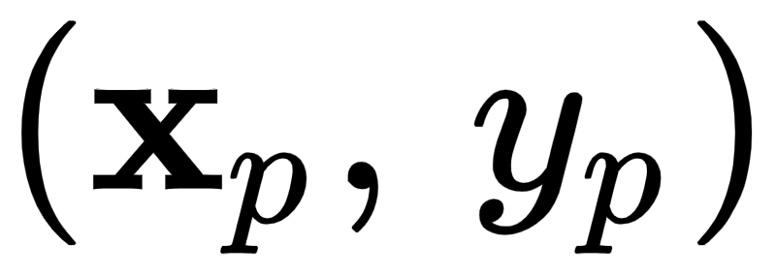
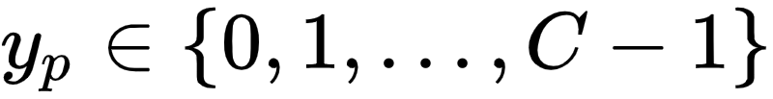
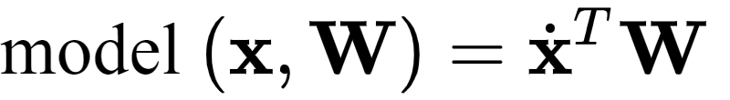

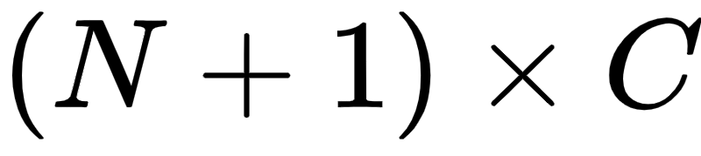
With mulit-class classification we have N input/output pairs where by default our label values lie in the set .
The joint linear model for all C classifiers takes the form
Here the weight matrix has dimension

Slide 4

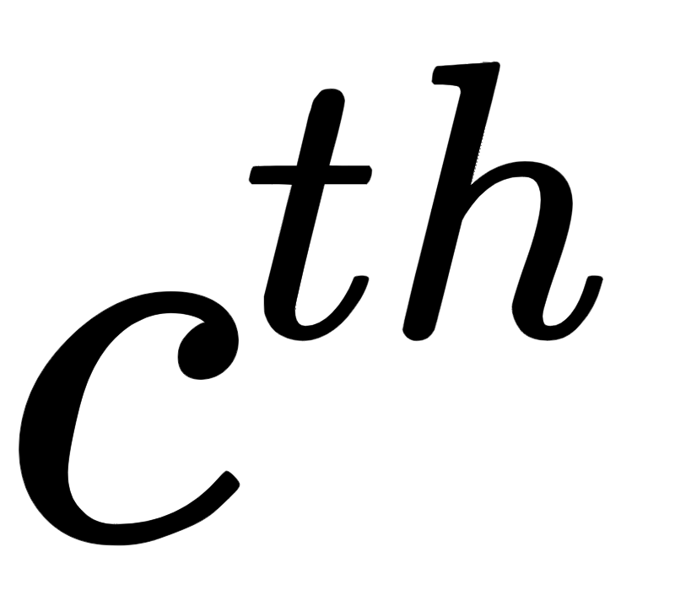
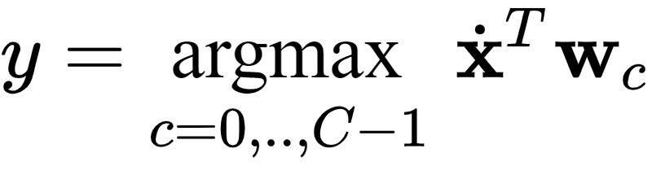
Notice that this is precisely the same linear model used with multi-output regression.
We can safely wager that the *nonlinear* extension of multi-class classification takes a similar form to that discussed for multi-output regression.
With the parameters of the matrix fixed we make predictions based on the *fusion rule*, denoting as the column of

Slide 5
We can tune the parameters of the joint model *one column at a time* by solving a sequence of C two-class subproblems *independently*: this is the One-versus-All approach.
We can also tune the parameters of *simultaneously* by minimizing an appropriate multi-class cost function over the entire matrix at once using e.g., the Multiclass Softmax/Cross-Entropy cost

Slide 6
Similar to the linear case, in general we have two main avenues for moving to nonlinear multi-class classification. We can either:
employ a One-versus-All approach and use precisely the framework for nonlinear two-class classification introduced previously with each of our C two-class subproblems
or, introduce nonlinearity *jointly* across all C classifiers and tune all parameters simultaneously

Slide 7
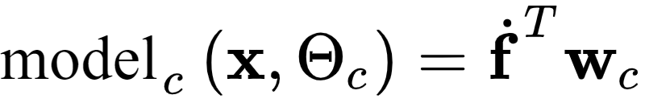

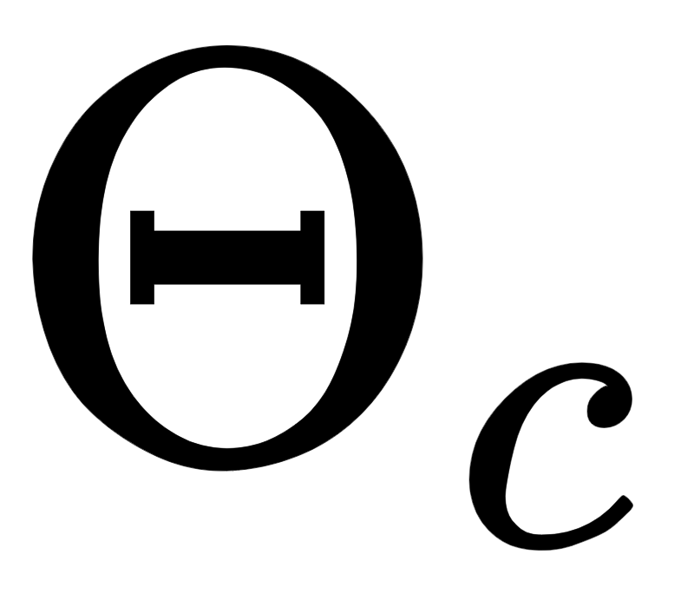
If we choose a *single set of features* for all C of our models we can express the of which compactly as
Here the notation is used to compactly denote our B feature transformations
as the linear combination weights and denotes the entire set of parameters (including any parameters internal to the feature transformations)

Slide 8

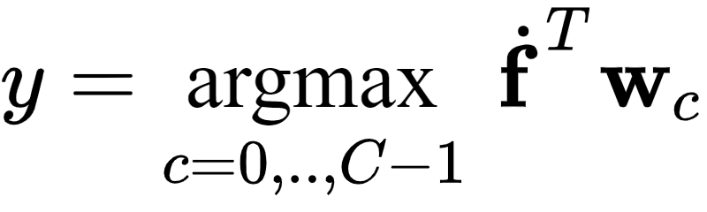

Once each model has been tuned properly we predict the label of an input point employing the fusion rule across all C of these nonlinear models - mirroring our approach in the linear setting
To properly tune the parameters we must minimize an appropriate cost, e.g., the Multiclass Softmax

Slide 9
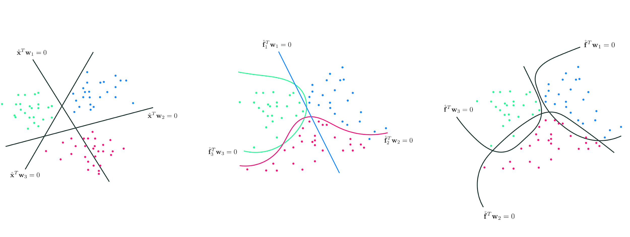
(left) Linear multi-class classification. (middle) Nonlinear multi-class classification: independent scheme. (right) Nonlinear multi-class classification: feature-sharing scheme.

Slide 10
Feature engineering

Slide 11
Example: Nonlinear One-versus-All multi-class classification

Slide 12
In this example we perform One-versus-All multi-class classification on the dataset shown below, which consists of C=3 classes that appear to be separable by elliptical boundaries.

Slide 13
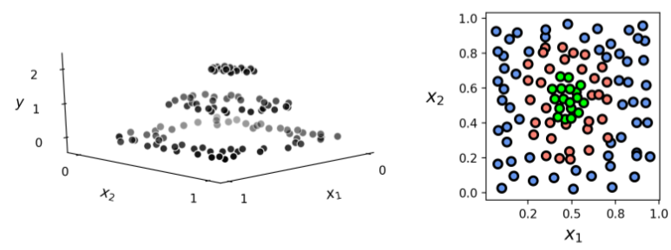

Slide 14
It looks like the classes of this dataset can be cleanly separated via elliptical boundaries
To capture this behavior we will use a full degree-2 polynomial expansion of the input
We solve each of the C two class problems (via minimizing the Softmax cost) using gradient descent, and plot each resulting two-class classifier, as well as the combined results determined by the fusion rule.

Slide 15
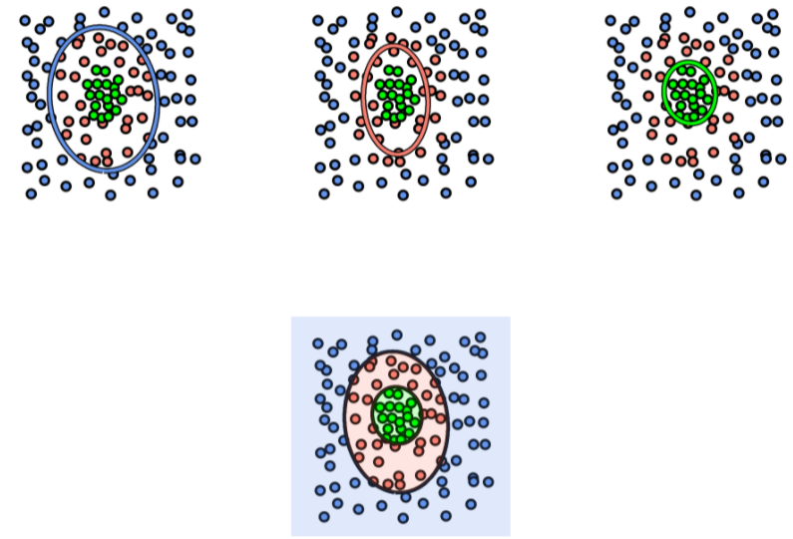

Slide 16
Below we repeat the same experiment on the same dataset, as well as the same set of polynomial feature transformations, but now use the Multi-class Softmax cost function to perform classification simultaneously.

Slide 17
